Slide 1




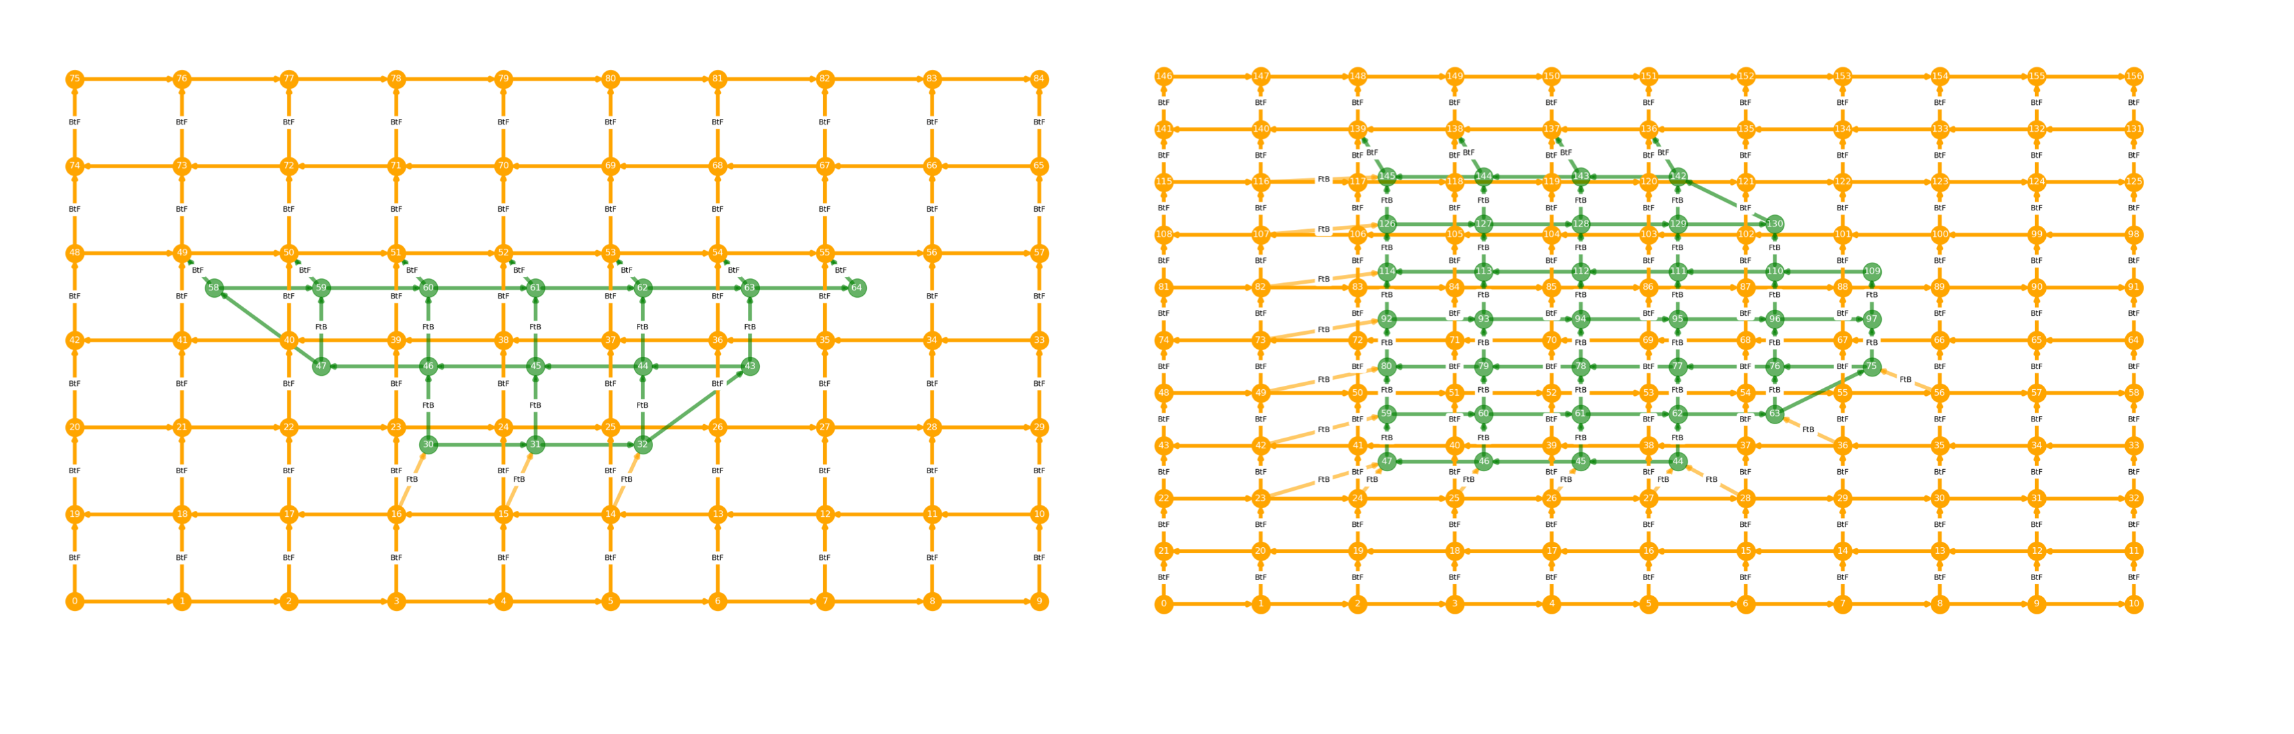
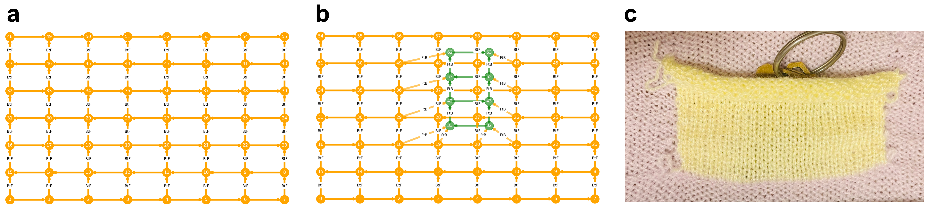
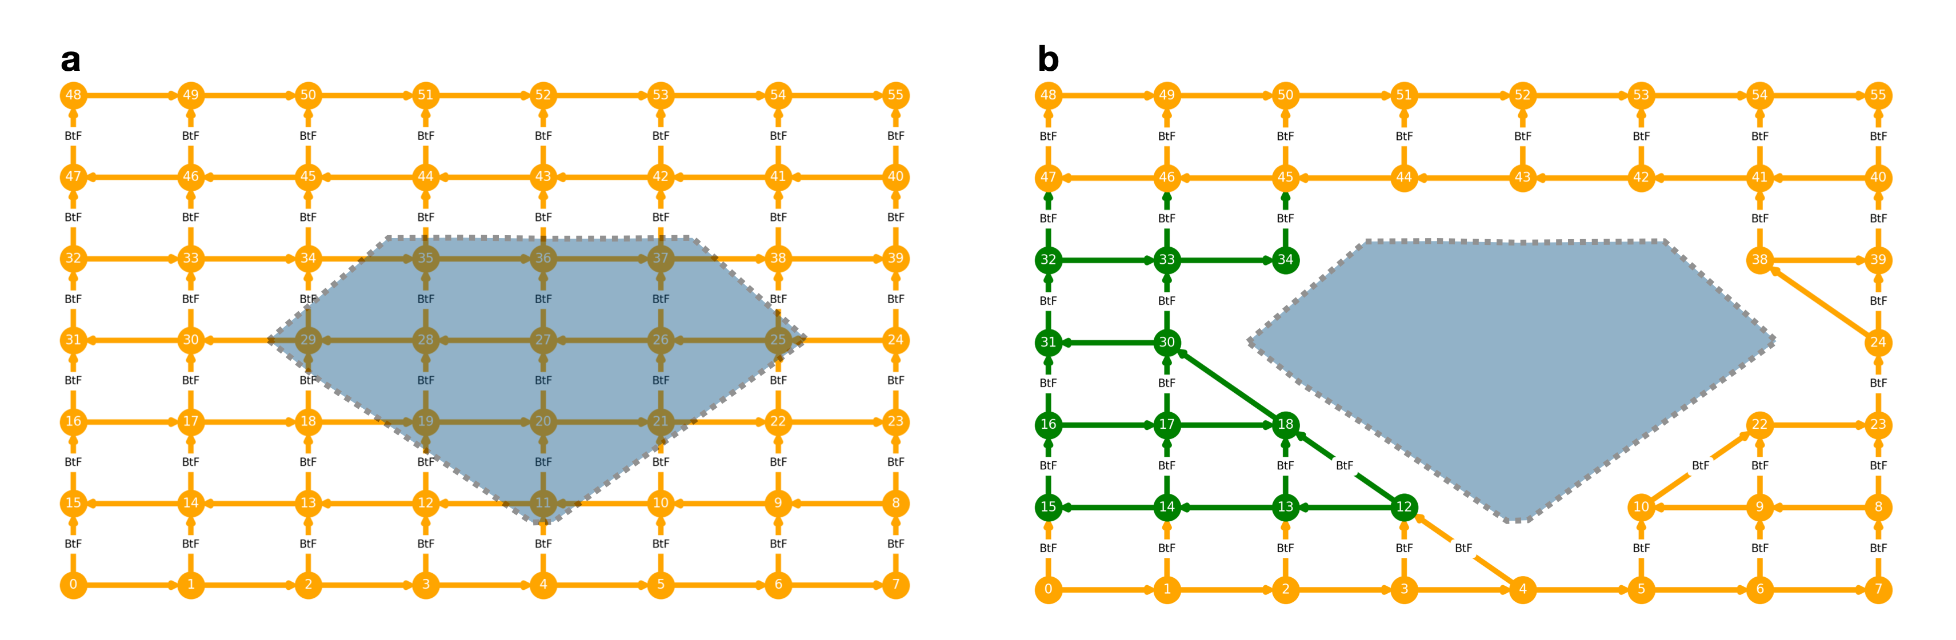
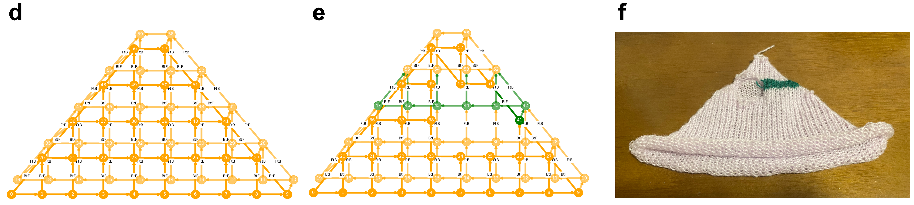
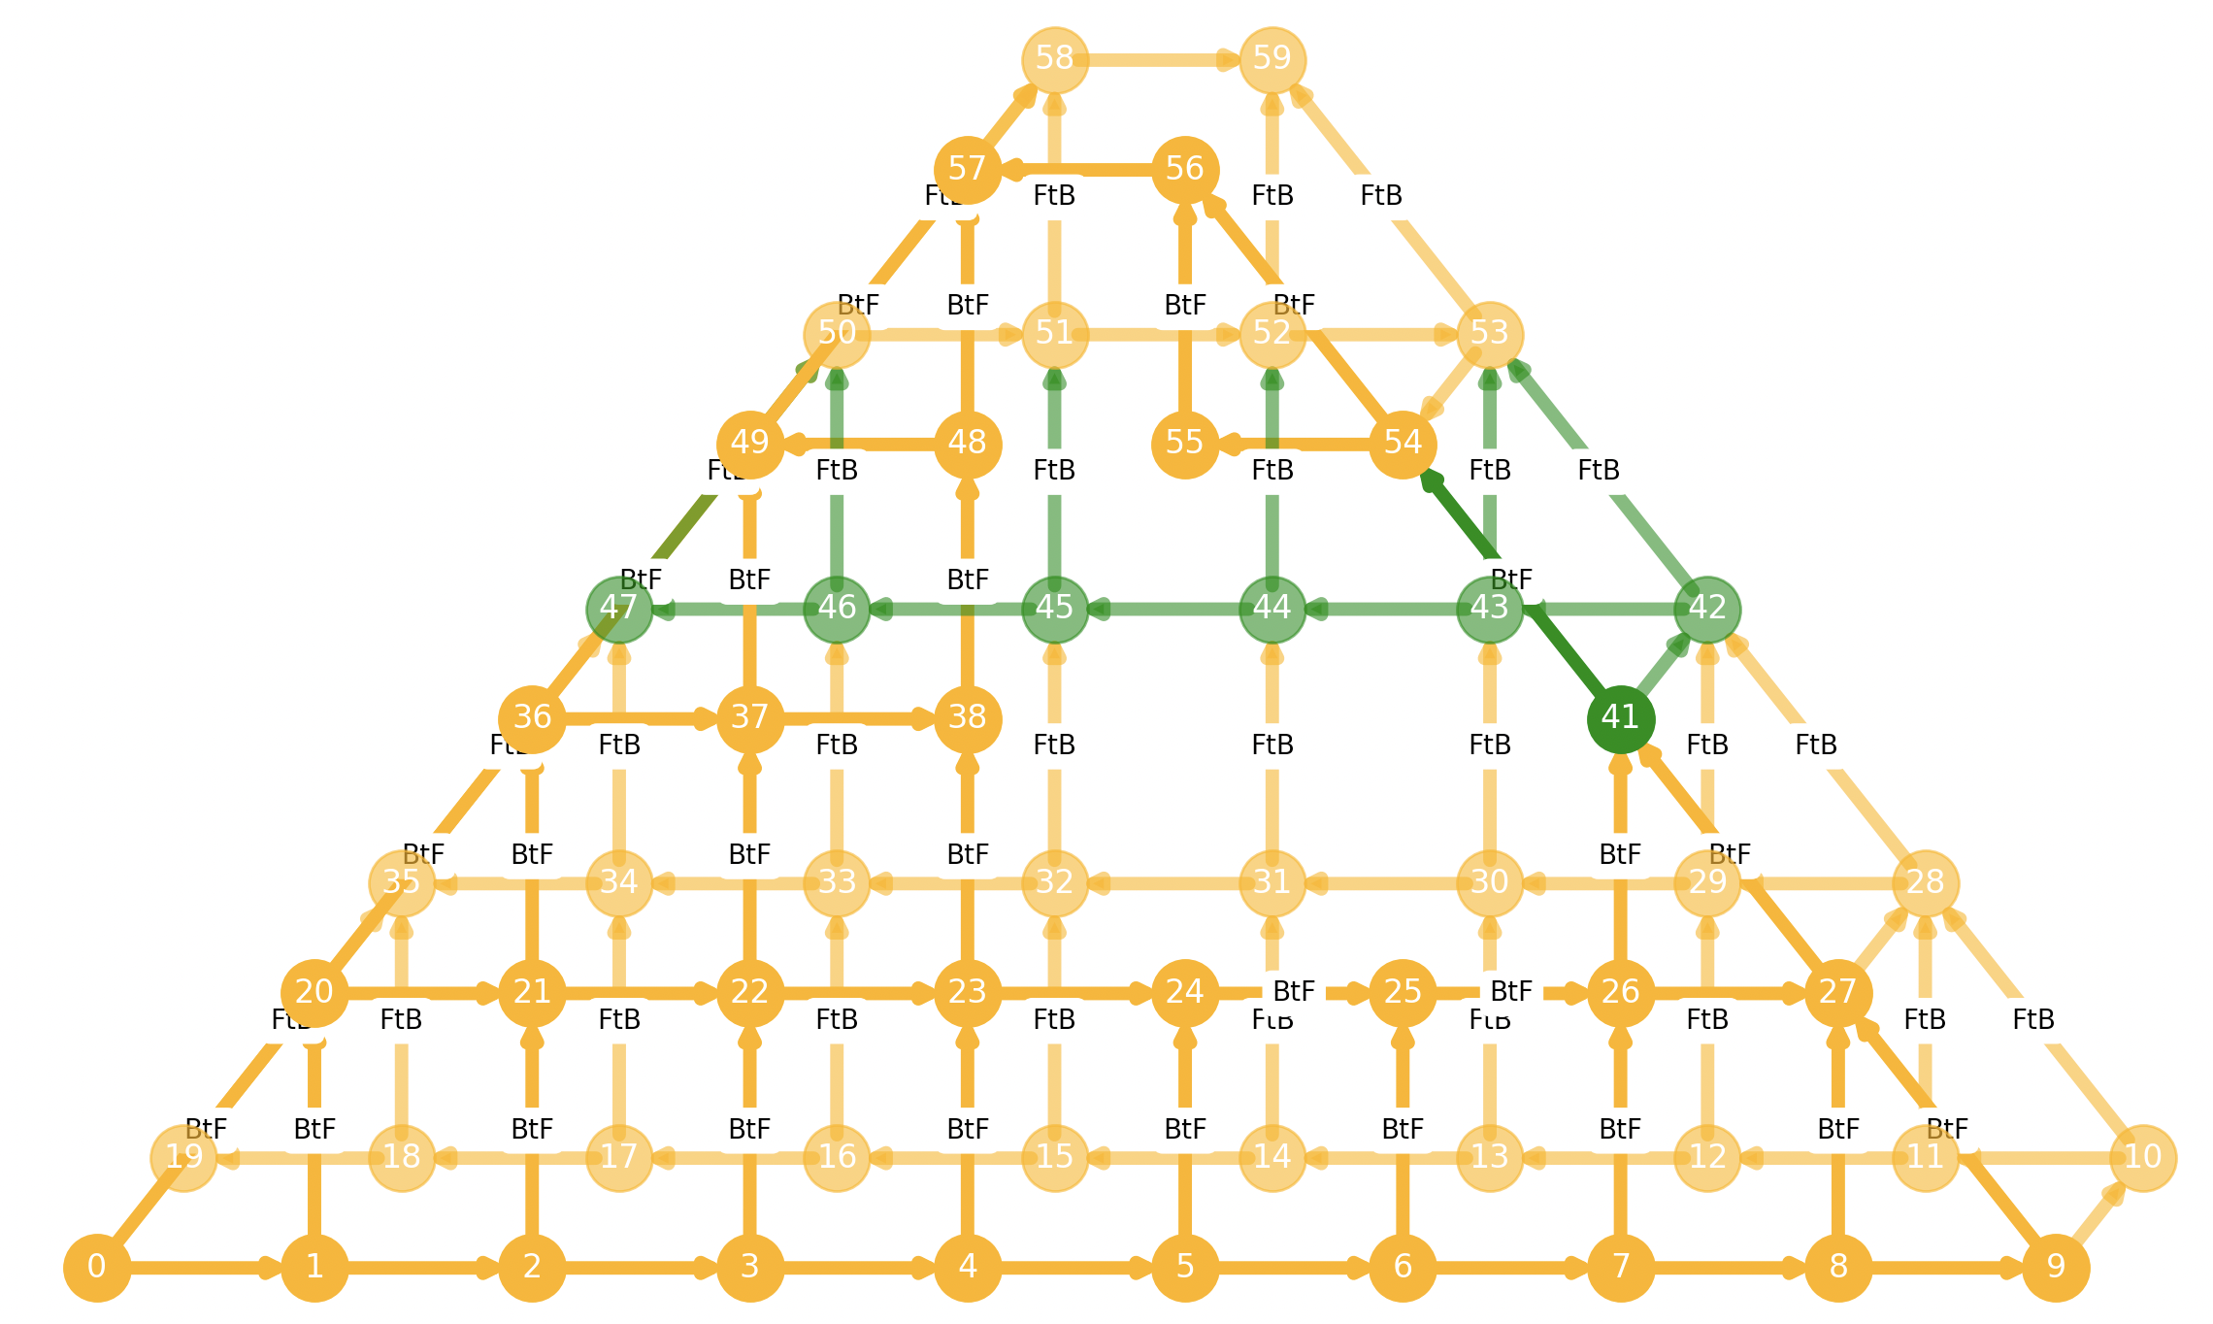
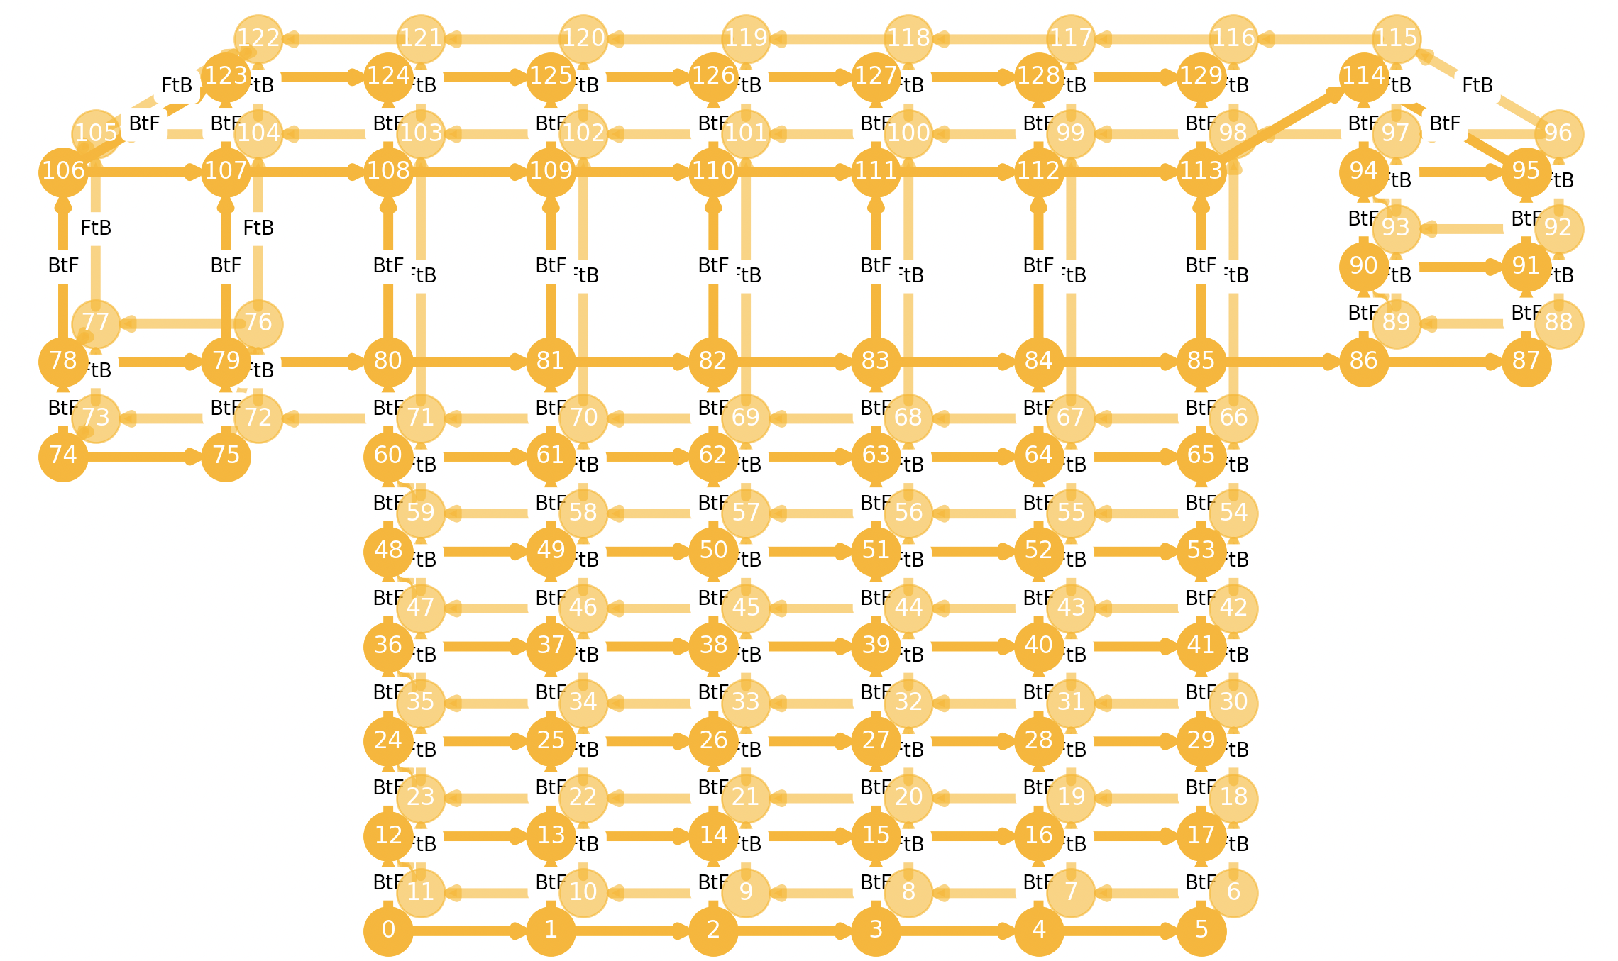
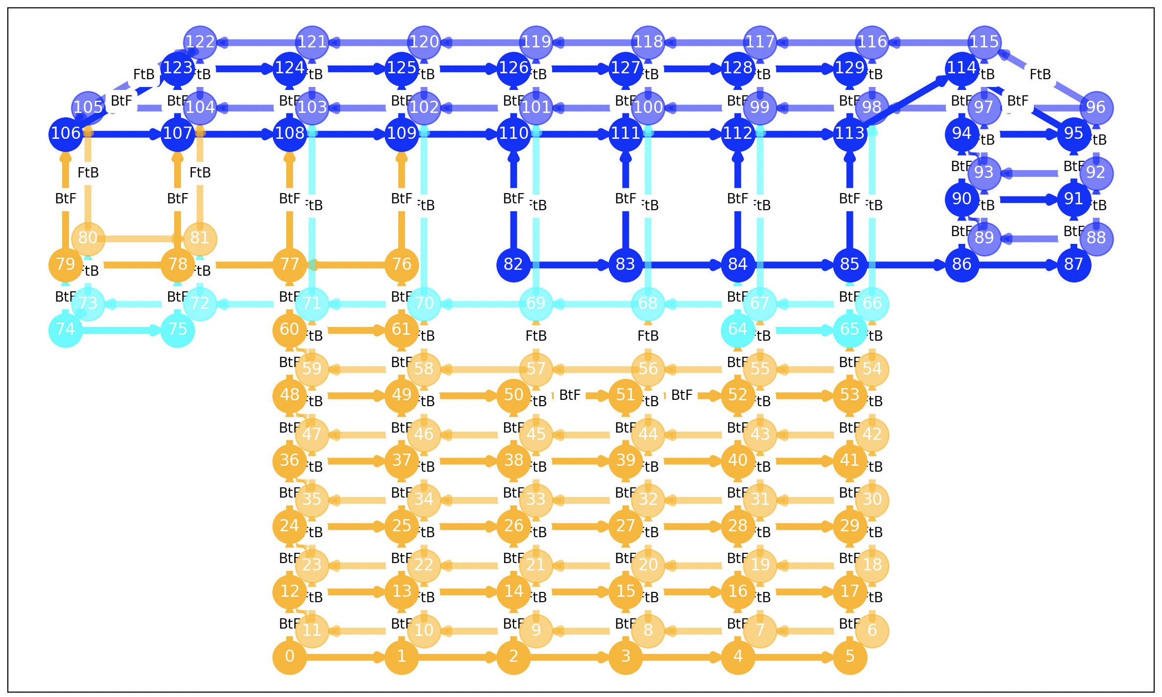
Fabricating Accessible Designs with Knitting Machines
Tongyan Wang¹ Jennifer Mankoff¹ Megan Hofmann²
1University of Washington 2Northeastern University
Why We Care About Knitted Object Customization
Pockets
A kangaroo pocket added on a stockinette.
A zipper jacket pocket added on a stockinette.
Facilitate Accessibility
> Better accommodate limb
differences & body shape variations.
> Add holders and openings for
medications, assistive technology,
and other body modifiers.
> Address historical injustices (e.g.
lack of pockets in women's
clothing).
Change Research Landscape
> Industrial Knitting Software assumes
the same object will be fabricated
repeatedly without modifications
Our system supports 1) adding most polygon-shaped pockets at any feasible graph location; 2) attaching any edge of the patch side to the fabric.
Pipeline Workflow
Pre-designed KnitGraphs of knitted objects -> Modified the KnitGraphs to add accessible designs -> Generate machine instructions with our scheduling algorithm.
Two Accessible Designs Supported in Our Pipeline
Holes
A sheet with a diamond hole.
A shirt with a hole.
Limitations and Future Work
> Expand design space to incorporate more knitted
objects by introducing 3D meshes.
> A novel approaches to transfer planning that can
handle up to three layers of fabric.
> Build an interactive system that can easily visualize
garments and hand it to end users to directly
manipulate knit objects to add holes and pockets.
Our system supports 1) adding variously shaped holes at any feasible graph location; 2) detecting pattern errors.
Acknowledgements
Thanks to CREATE and NSF IIS-1907337.

